Slide 1
Inclusion and Special Educational Needs
Bath
3.03.2019 – 09.03.2019

Slide 2
Learning topic
Orientation on maps (of England/Bath)
Learning historical facts about the Circus in Bath by using maths skills

Slide 3
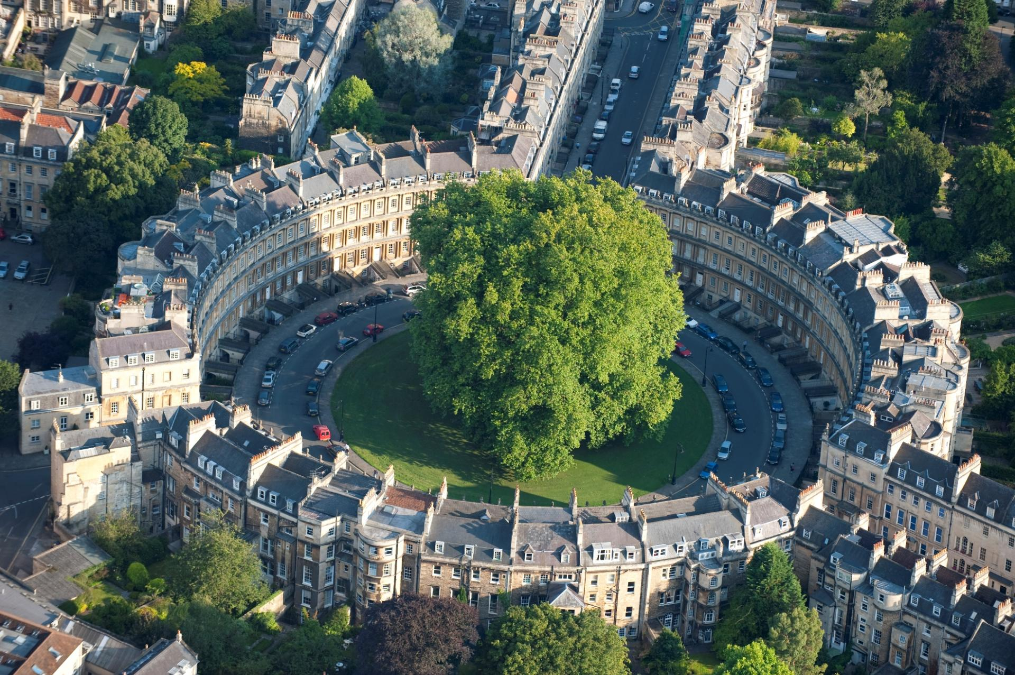
Circus in Bath

Slide 4
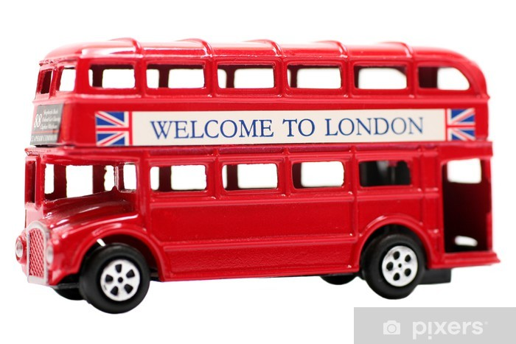
How to introduce the topic
Preparing the classroom with authentic English/British material to activate the pupils‘ fore-knowledge

Slide 5
Starter acitvity to motivate students warm - up
Encourage the pupils to tell the class what they already know about England by using the materials
Focussing on Bath → what is the origin of the name? (drawing connections to the English words bath/bathroom (or the German word Bad )

Slide 6
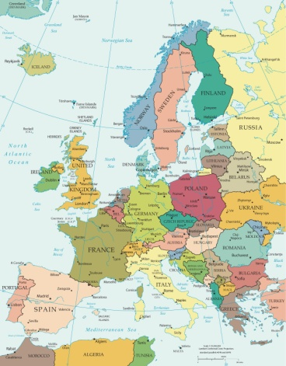
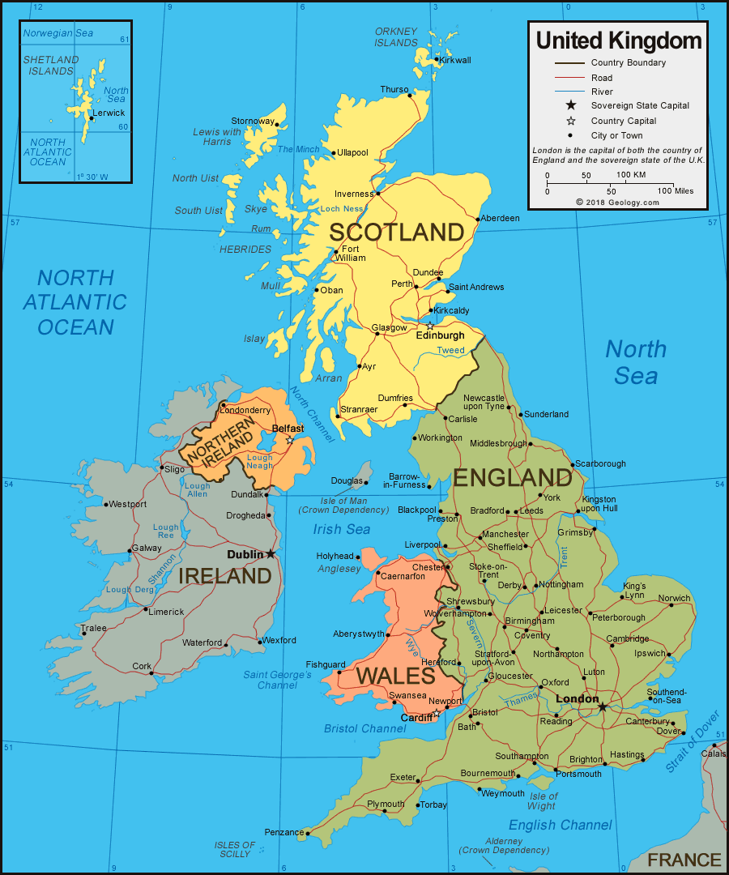
Main learning acitivities
Finding/showing the UK on the map of Europe …
… and England on the map of the UK
Finding/showing important sights on the Bath map
Finding and describing ways through Bath by using „right“, „left“, …
Focussing on the Circus with additional acitivities

Slide 7
Differentiated activities on The Circus
Reading texts with information about the Circus → marking important information and answering questions like:
How many years did it take to complete the Circus?
Who was the architect of the houses?
How many acorns are on the houses altogether?
Estimate how many windows are there altogether.
How many trees can be seen in the middle of the cirle?
…
What is the shape of the Circus?

Slide 8
Closing activities
Every pupil/group tells the class about the results of his/its work
Every pupil tells the class about the most surprising/important/… fact that he has learnt

Slide 9
Language skills to be developed
Describing a way by using „left“, „right“ and words of direction
Using new vocabulary (map, Europe, England, circle, …)

Slide 10
SEN activities
Multi-sensorical approach/support
Fine motoric support
Working with maps on different levels
Providing differentiated activities for each pupil

Slide 11
Evaluation of the lesson
Observing the pupils‘ work
Checking the responses
Feedback of the pupils by showing smileys/thumbs or by writing a short note

Slide 12
Erasmus+, Key Action 1 Learning Mobility of Individuals Teachers Mobility, School project „Technologies and English for each student“, № 2018-1-BG01-KA101-047460
Tatyana Dimitrova Bulgaria

